Slide 1
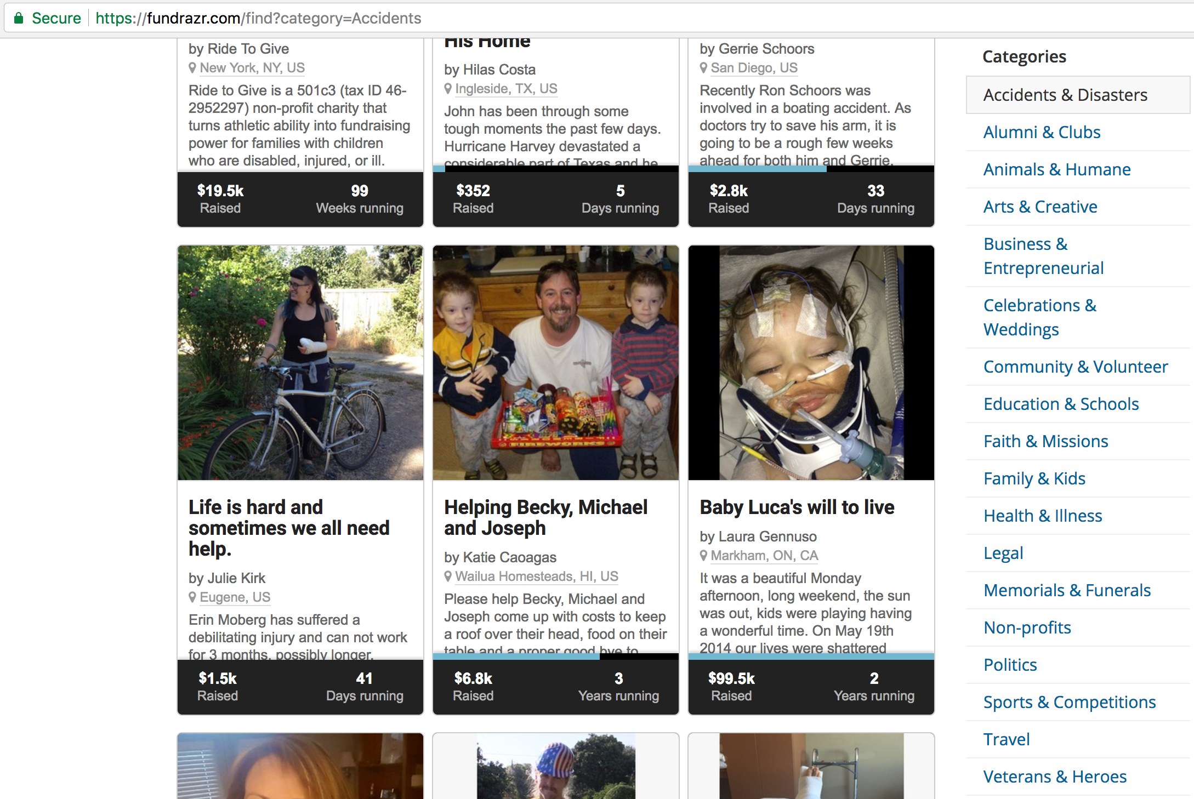
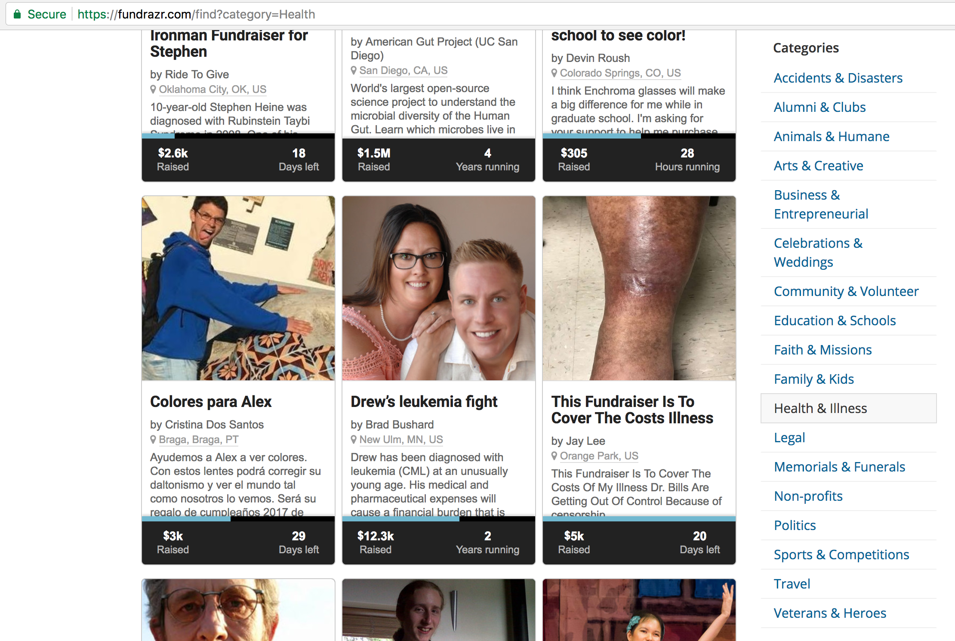

Slide 2
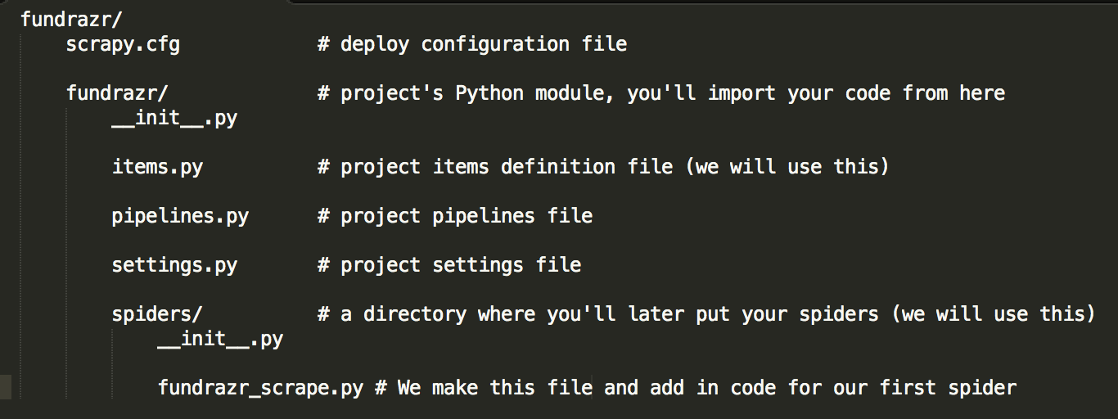

Slide 3
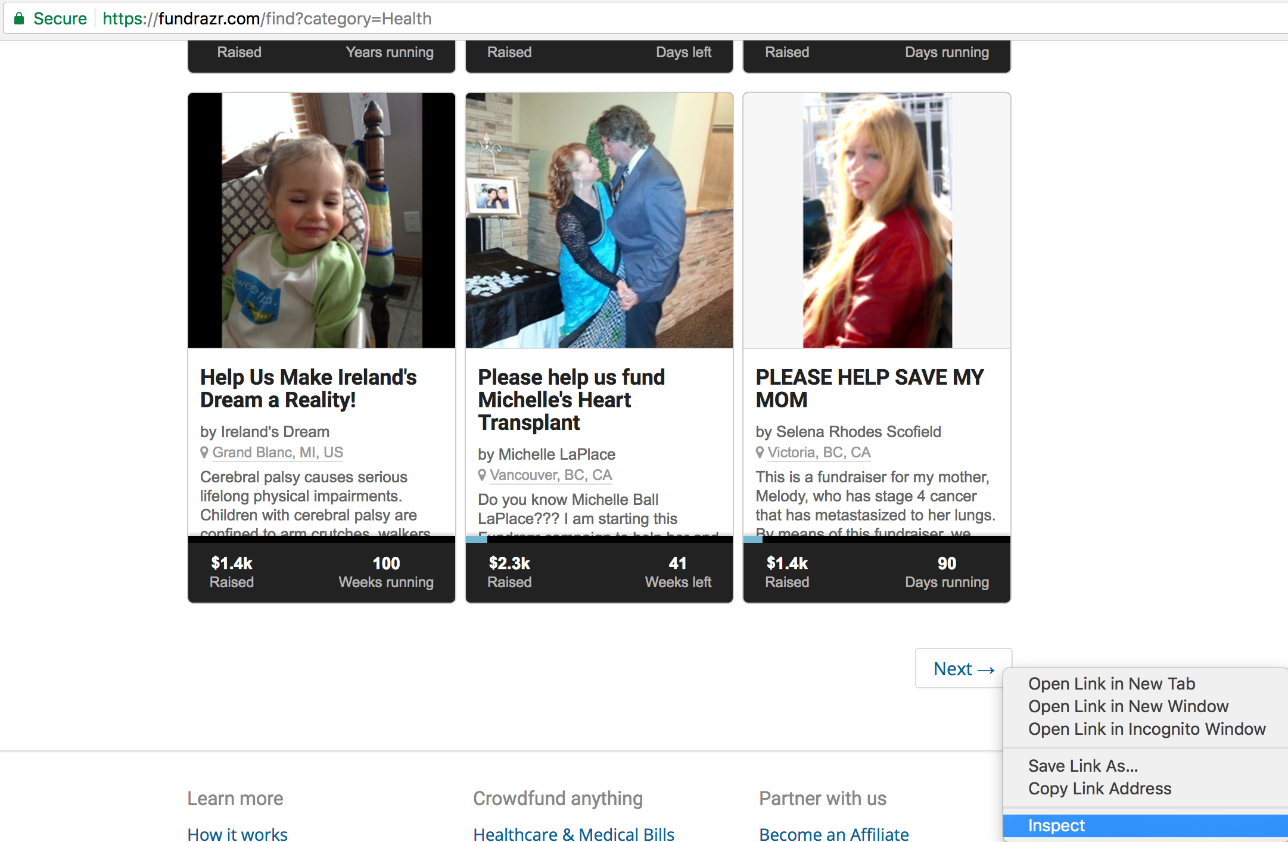
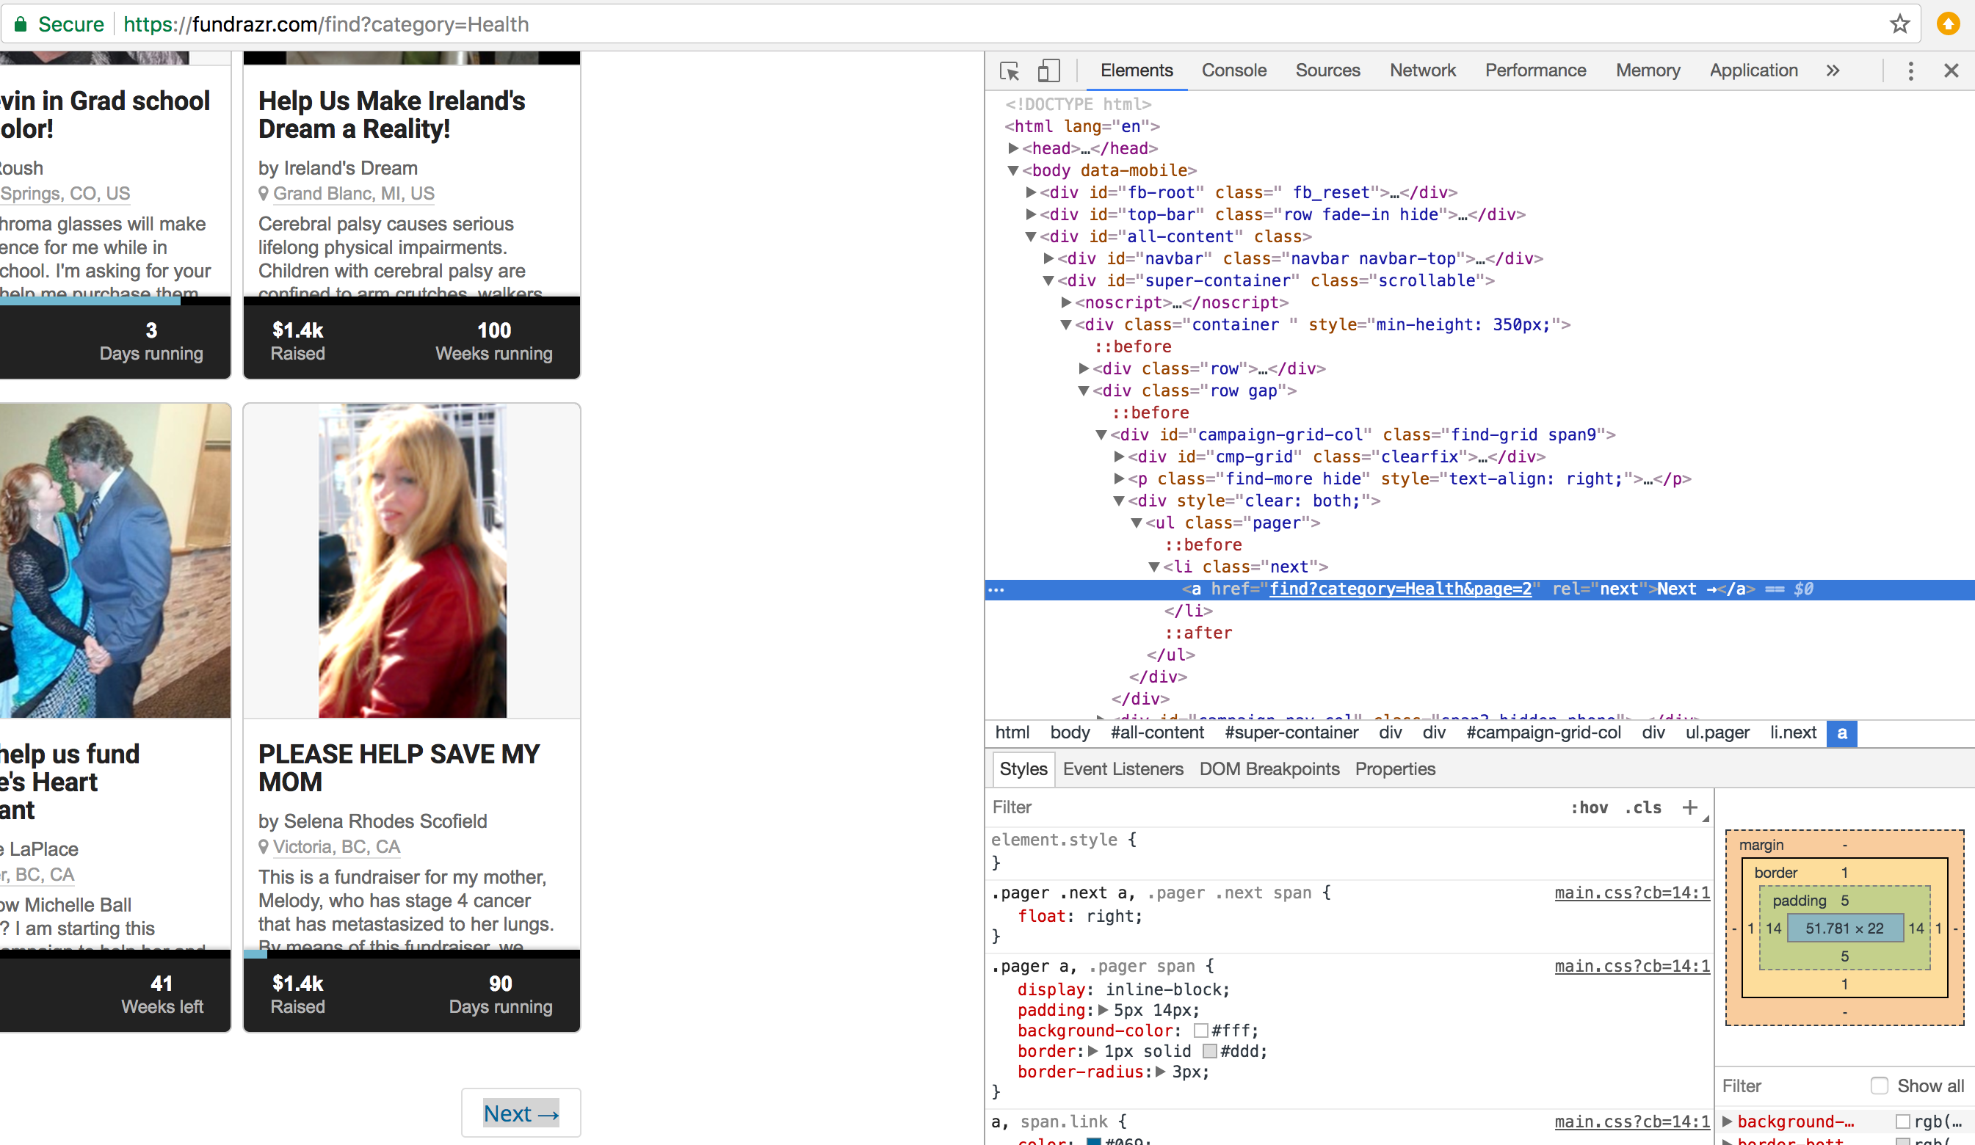
Right click on the ”Next” button (enclosed within the red rectangle) and then click on Inspect
The highlighted portion in blue just means we append the following to our url (if we want another page of campaigns): find?category=Health&page=2

Slide 4
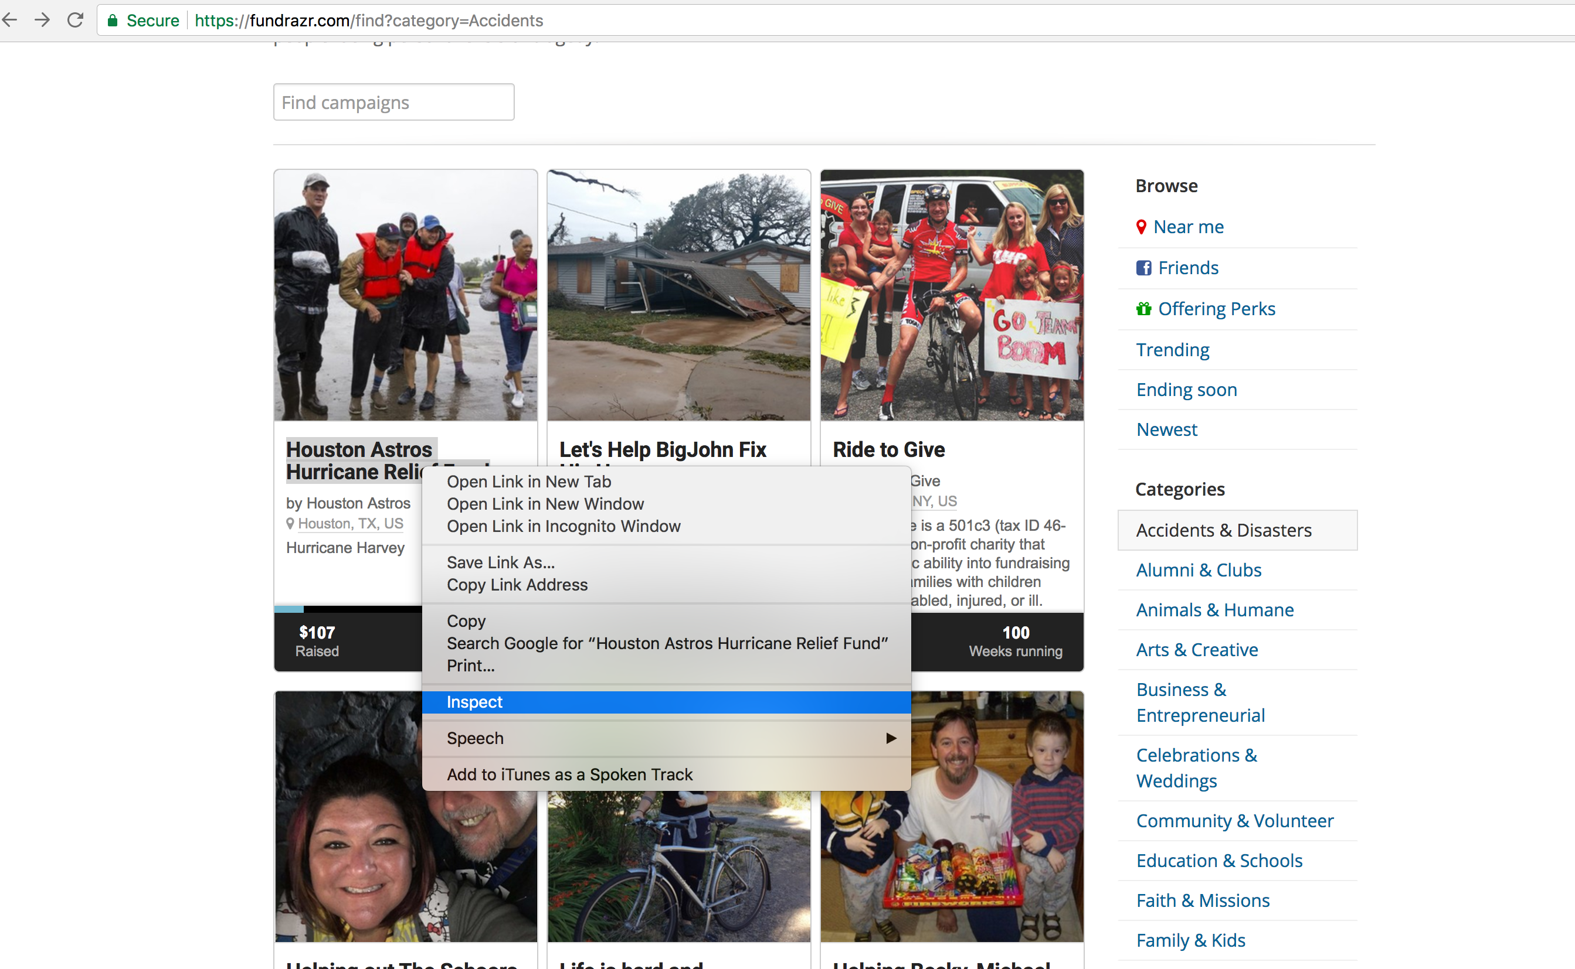
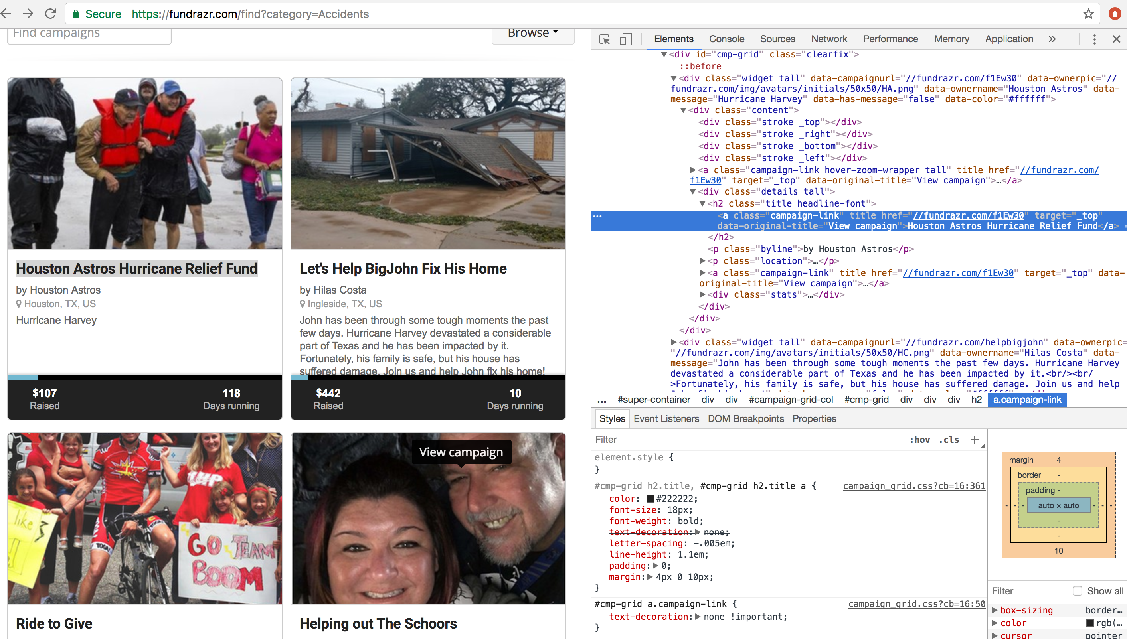
Right click on the title for the first campaign you see and then click on Inspect
The link (enclosed within the red rectangle) is the url for an individual campaign. We will scrape all the individual campaigns on a page.

Slide 5
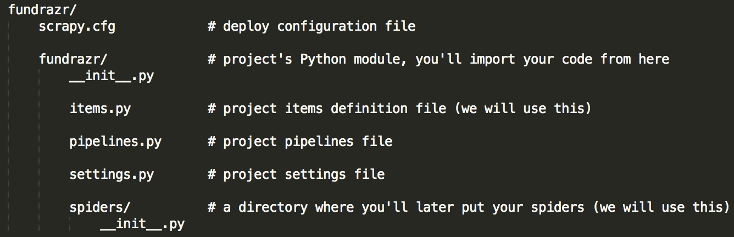

Slide 6
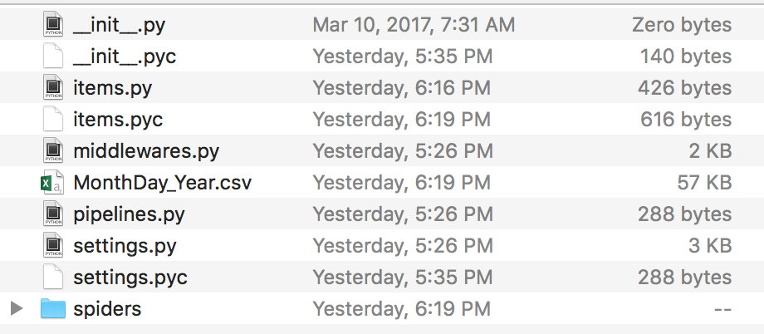

Slide 7


